Slide 1
Lets Recollect Deadlocks Edited version of slides available online

Slide 2
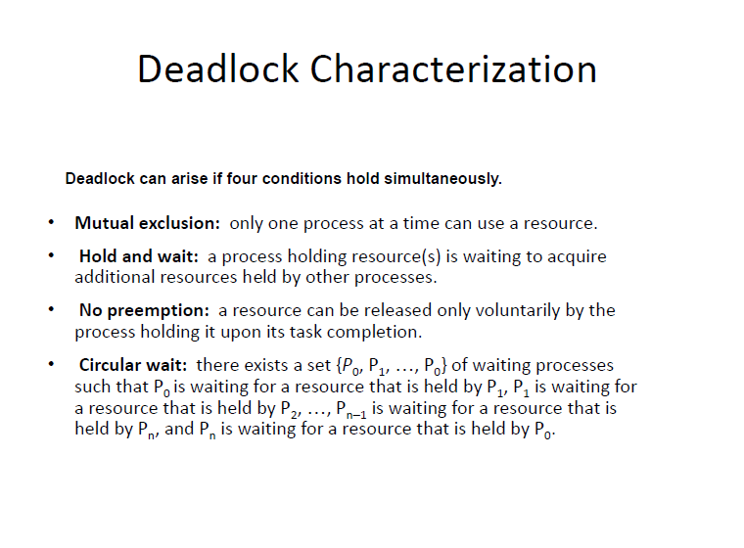
Revision

Slide 3
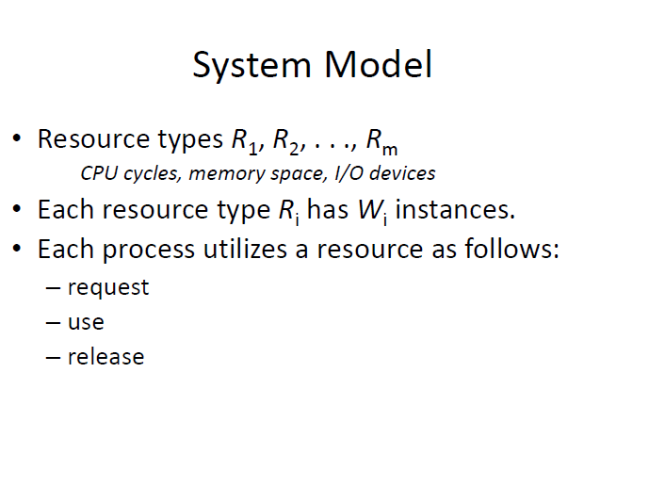

Slide 4
System Model
A process can be in two states:
Running or blocked.
In the running state (also called active
state), a process has all the needed resources and is either executing or is ready for execution.
In the blocked state, a process is waiting to acquire some resource.

Slide 5
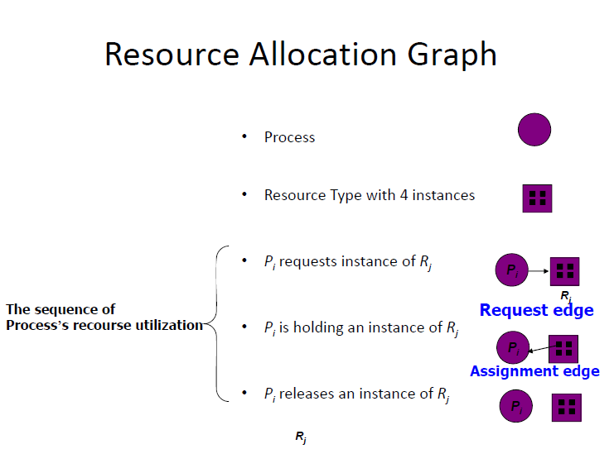

Slide 6
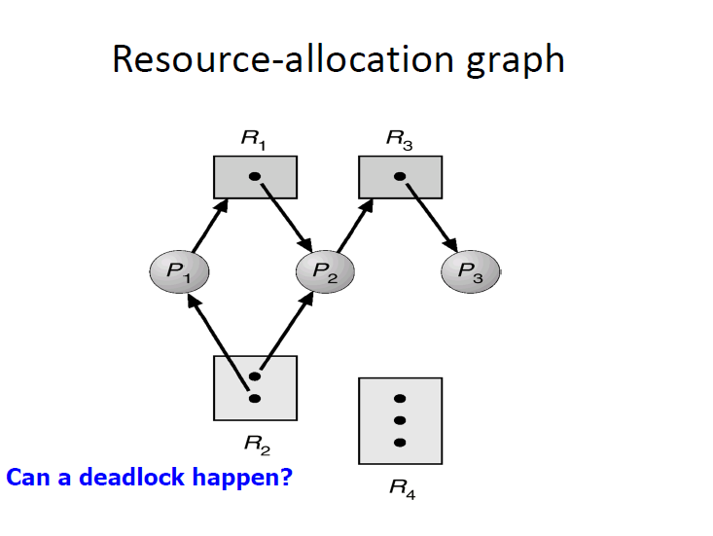
Does cycle indicate deadlock?

Slide 7
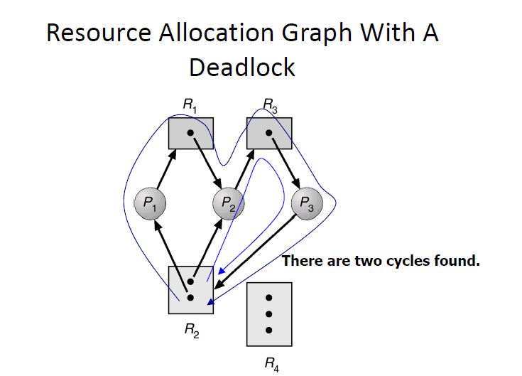

Slide 8
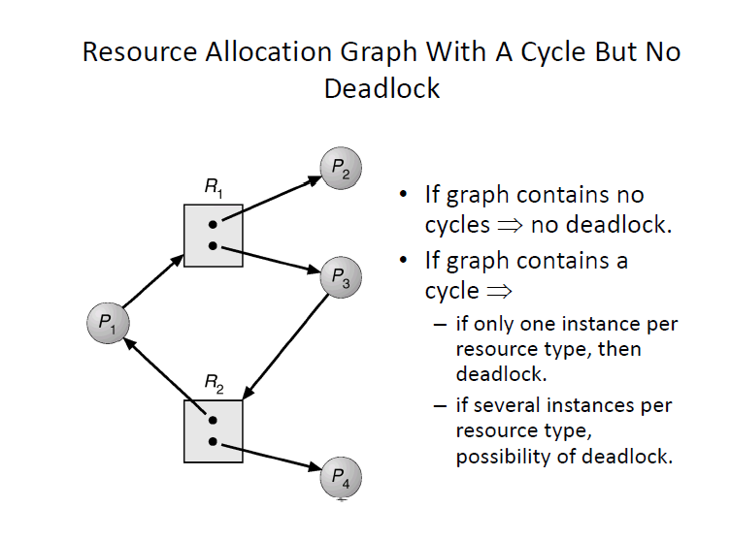

Slide 9
Wait for Graph
A wait for graph(WFG) is a graph where nodes are processes and there are edges from node P1 to node P2 if P1 is blocked and it is waiting for P2 to release some resource. A system is deadlocked iff there is a cycle or knot in the WFG

Slide 10
To the Distributed Setting
A distributed program is composed of a set of n asynchronous processes p1, p2, . . . , pi, . . . , pn that communicate by message passing over the communication network.
Without loss of generality we assume that each process is running on a different processor.
The processors do not share a common global memory and communicate solely by passing messages over the communication network

Slide 11
To The Distributed Setting
There is no physical global clock in the system to which processes have instantaneous access.
The communication medium may deliver messages out of order, messages may be lost garbled or duplicated due to timeout and retransmission, processors may fail and communication links may go down.

Slide 12
To The Distributed Setting
We make the following assumptions:
The systems have only reusable resources.
Processes are allowed to make only exclusive access to resources.
There is only one copy of each resource
Hence a system is deadlocked iff there exists a cycle or knot in WFG

Slide 13
Resource Request Models
The manner in which a task asks for resources can be
Single Resource request Model: can have at most one pending resource request
AND Resource request Model: Can request multiple resources. Task resumed only when all are acquired.
Example: (R1 AND R2 AND R3)
OR Resource request Model: Can request multiple resources. Task can resume when any one of the request resources becomes available Example: (R1 or R2) or (R1 or R2 or R3)

Slide 14
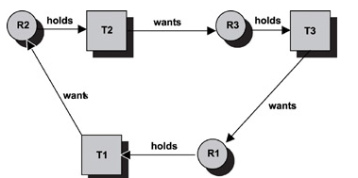
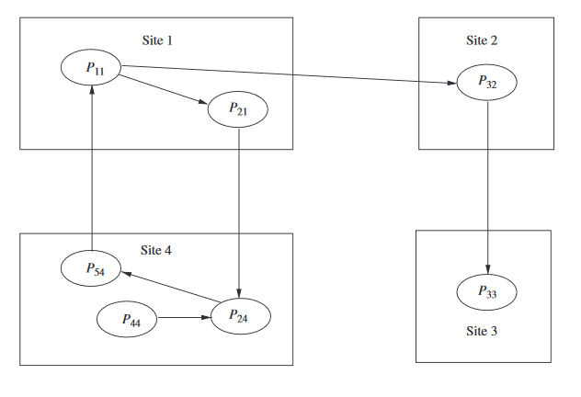
Single Resource Request
Model Presence of cycle indicates deadlock?
AND Resource request Model
If there is a cycle then there is a deadlock? there is a process deadlocked then will it be part of a cycle?

Slide 15
OR Resource request Model
If there is a cycle then there is a deadlock?
A knot(K) consists of a set of nodes such that for every node a in K,
all nodes in K and only the nodes in K are reachable from node a.
(SCC with no outgoing edge?)
A knot indicates a deadlock in the OR Model. Are processes in knot alone deadlocked?

Slide 16
OR Resource request Model
If there is a cycle then there is a deadlock?
No, P33, then P32 and then P11 will run
A knot(K) consists of a set of nodes such that for every node a in K,
all nodes in K and only the nodes in K are reachable from node a.
(SCC with no outgoing edge?)
A knot indicates a deadlock in the OR Model. Are processes in knot alone deadlocked? No..P44 too is

Slide 17
